Slide 1
C3 topic1-Diffusion
Wenting Chai

Slide 2
Learning objectives
Define diffusion.
State that the energy for diffusion comes from the kinetic energy of random movement of molecules and ions.
List 3 examples of diffusion in organisms (plant and animals).
Suggest how does these factors affecting rate of diffusion, limited to surface area, temperature, concentration gradients and distance.
Can correctly use terminology like diffuse, concentration gradient.

Slide 3
Terminology (Key terms)
Diffusion/ diffuse
Molecules, substances, particles (instead of ‘things’)
Concentration gradient
Partially permeable membrane
Osmosis
Water potential
Turgid, flaccid, shrink, swell, plasmolysis
Turgor pressure (the exerting pressure/ force pushes against cell wall by cytoplasm in plant cells)
Active transport
Other words like alveolus/ air sac, trachea, stoma.

Slide 4
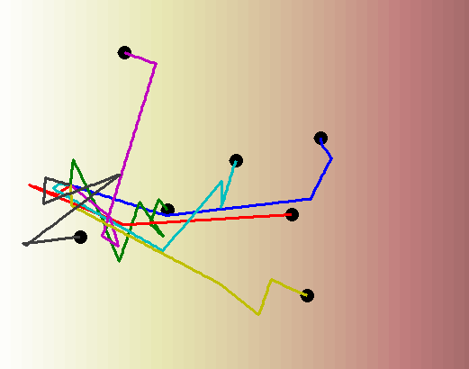

http://www.mit.edu/~kardar/teaching/projects/chemotaxis(AndreaSchmidt)/grad_2D.gif

Slide 5
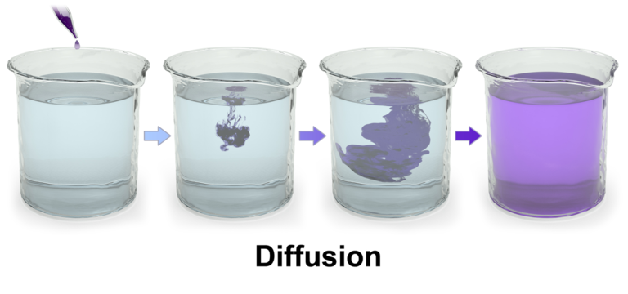
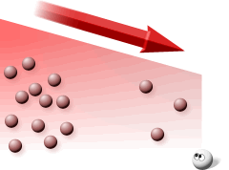
Diffusion
Definition:
the net movement of molecules and ions
from a region of their higher concentration to a region of their lower concentration down a concentration gradient,
as a result of their random movement.
Notes:
Net: remaining after all deductions
Equilibrium: (chemistry) a state in which a process and its reverse are occurring at equal rates so that no overall changeis taking place.

Slide 6
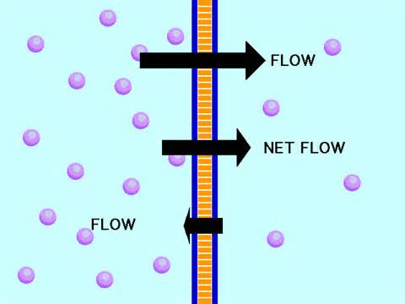
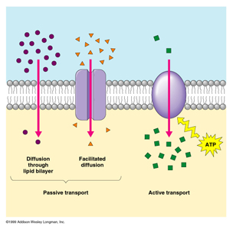
Net movement
outside cell
inside cell

Slide 7
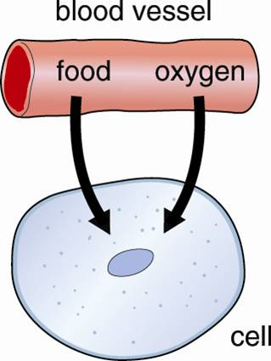
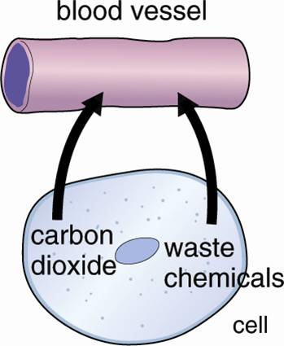
Diffusion in biology

Slide 8
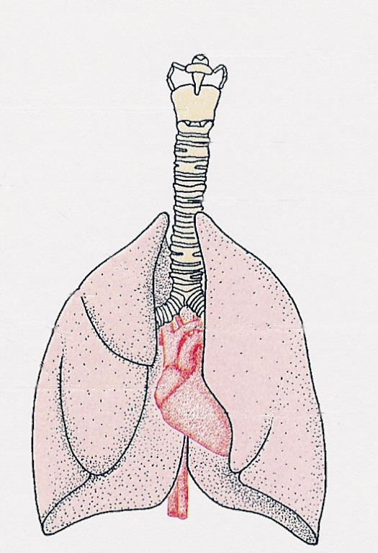
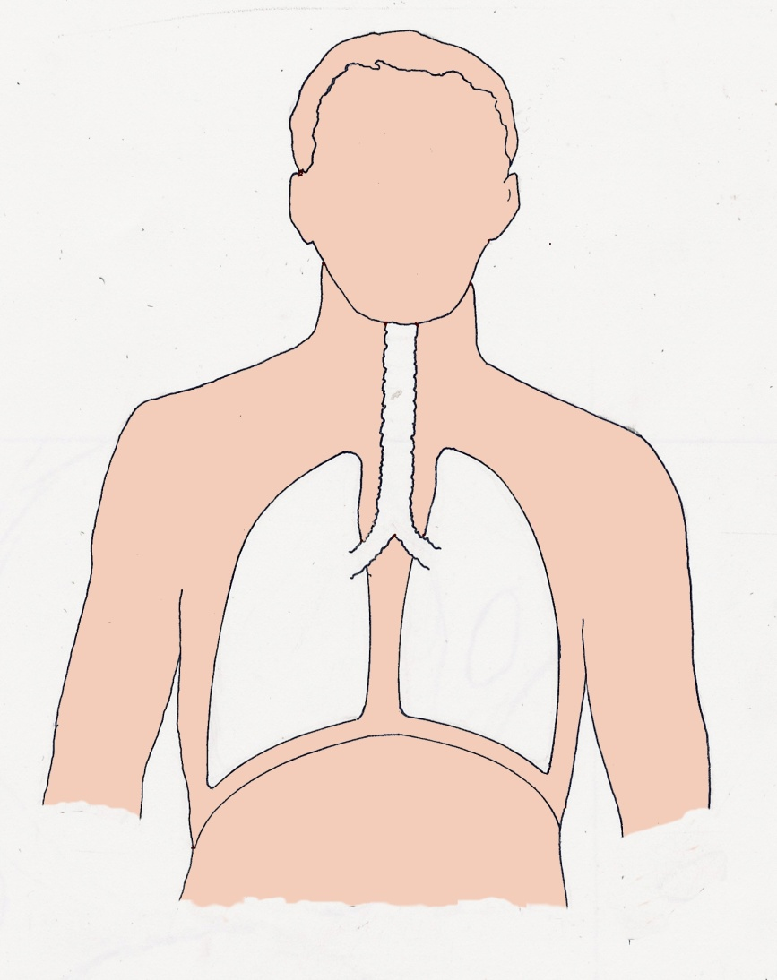
Human lungs
windpipe
lung
diaphragm
position of lungs
in thorax
heart
human lungs
Notes:
The lungs are not hollow, but spongy. They are made up of thousands of tiny air pockets

Slide 9
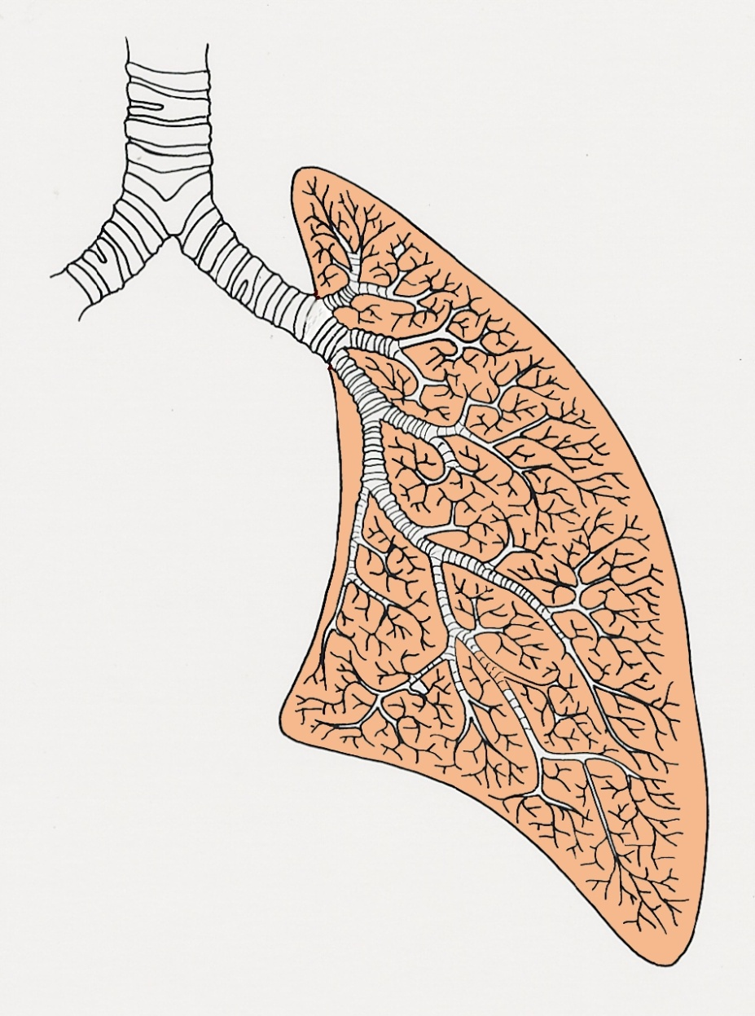
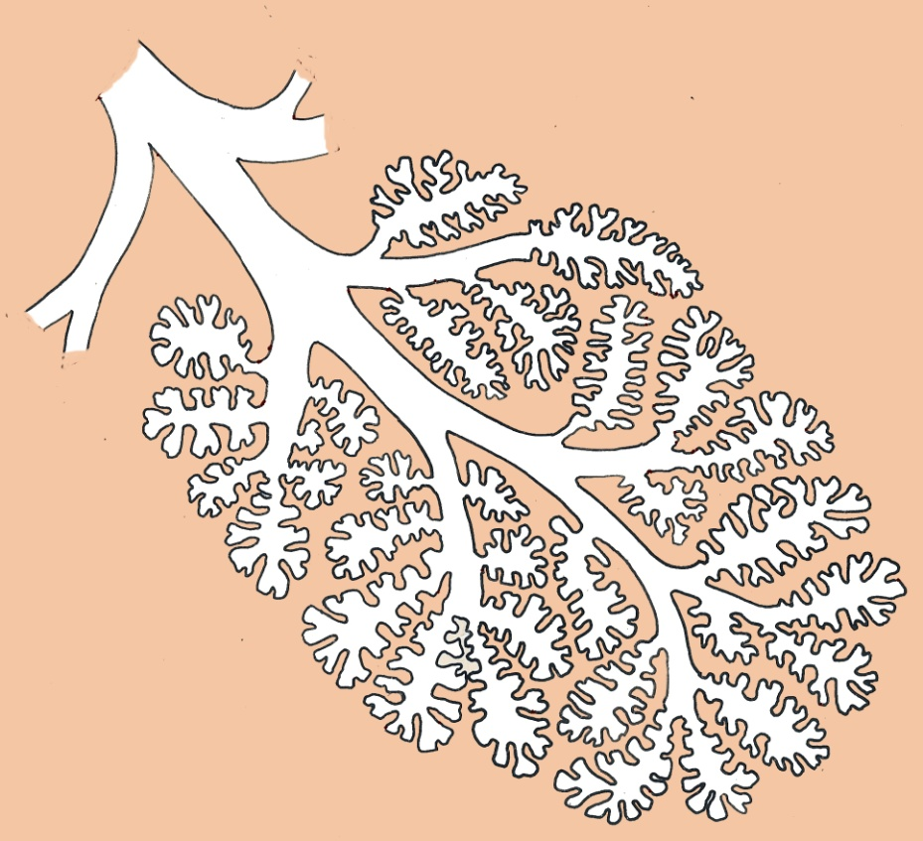
Lung Structure
each tube ends up in
a cluster of tiny air
sacs.
the air passages in the lung
branch into finer and finer tubes
Notes:
The windpipe (trachea) divides into two smaller passes (bronchi) which continue to divide repeatedly into smaller and smaller branches until they end up in tiny, thin-walled air pockets (air sacs)..

Slide 10
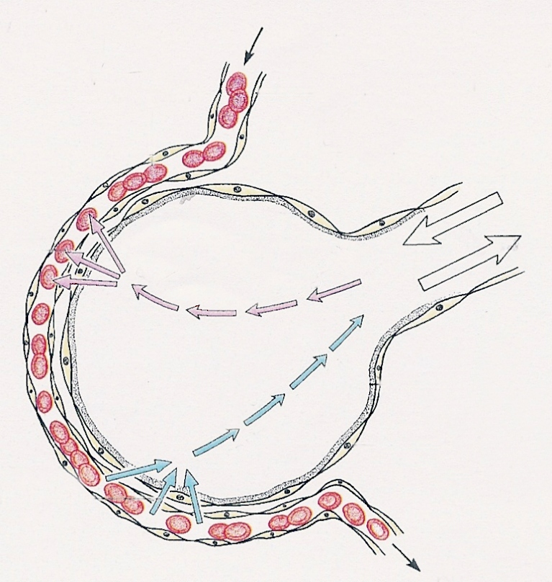
A single air sac
blood supply to air sac
diffusion of
oxygen
air breathed
in and out
diffusion of
carbon dioxide
O₂
CO₂
0.03 mm
Notes:
The air is carried to the air sacs by the breathing movements. Oxygen then diffuses across the air sac, though the single cell layer lining the air sac, and into the blood vessels.
Carbon dioxide diffuses in the opposite direction.

Slide 11
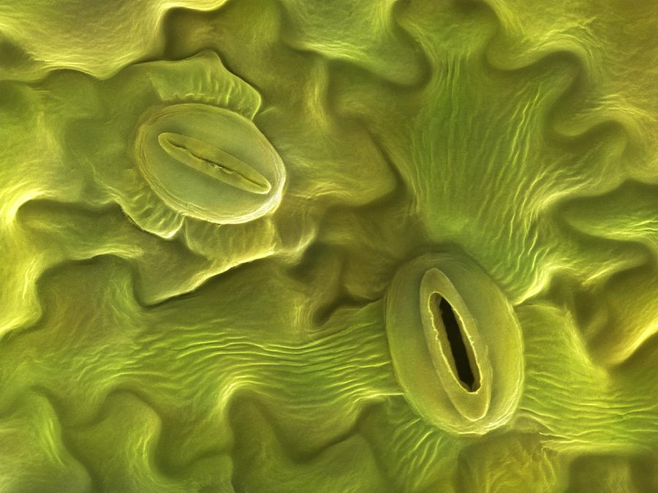
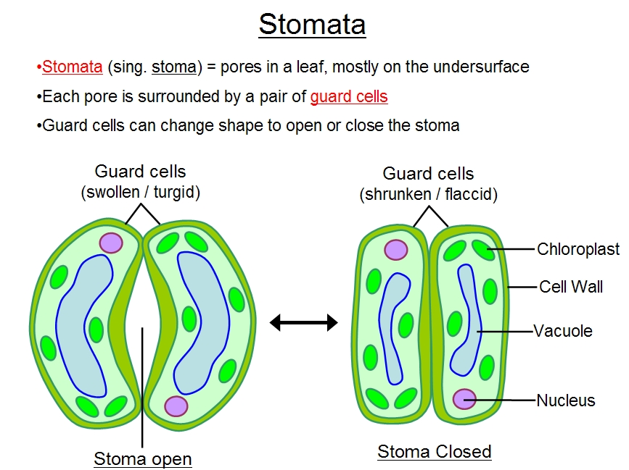
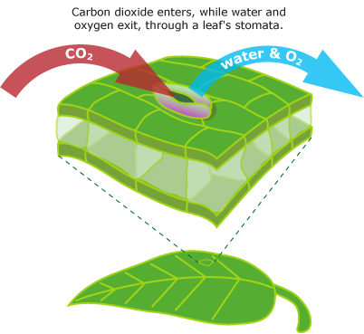
Diffusion in biology

Slide 12
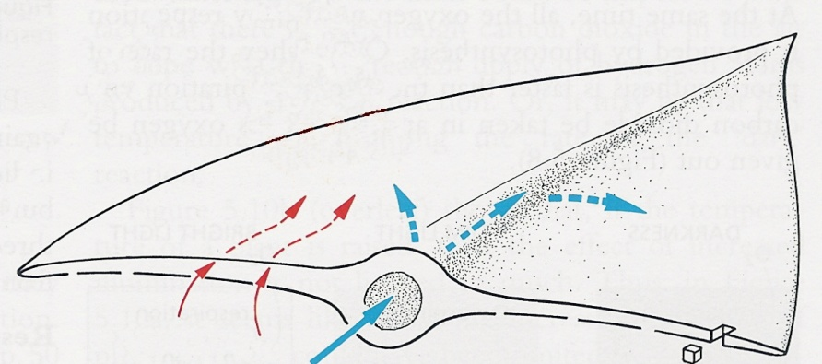
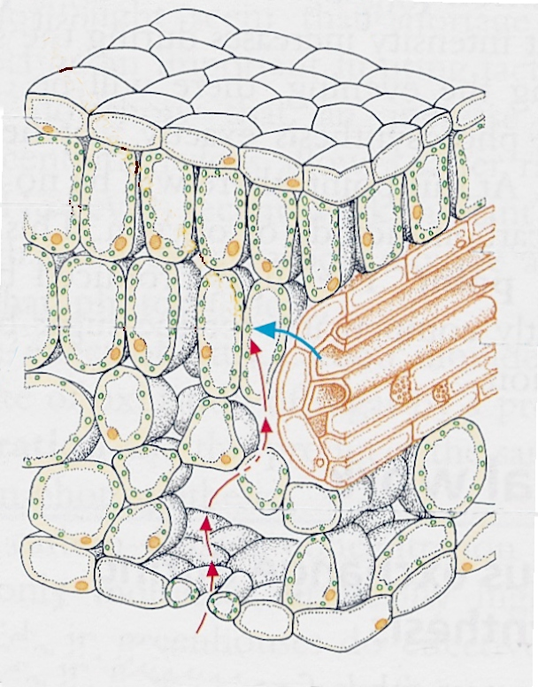
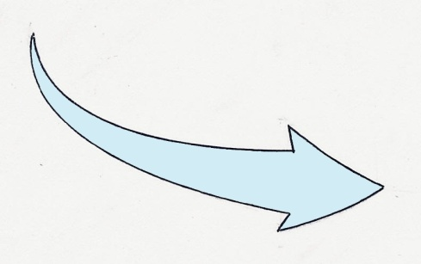
Leaf
26
O₂ and CO₂
diffuse through
pores in the
epidermis
the ‘veins’
bring water
In a thin leaf, the
diffusion distance
is short
O₂ and CO₂ diffuse
into the spaces between cells
Notes:
The leaf needs carbon dioxide for photosynthesis and oxygen for respiration.
These gases diffuse through pores in the leaf’s epidermis and enter the air spaces between cells. They then diffuse through the cell wall into the cytoplasm.

Slide 13

Misconceptions about diffusion
1) The movement of particles in diffusion is purposeful – the particles try to move so that they end up evenly spaced.
- No. It’s just random movement.
2) The cells make substances diffuse.
E.g. The cell diffuses oxygen into itself.
- No. Oxygen diffuses into the cell.

Slide 14
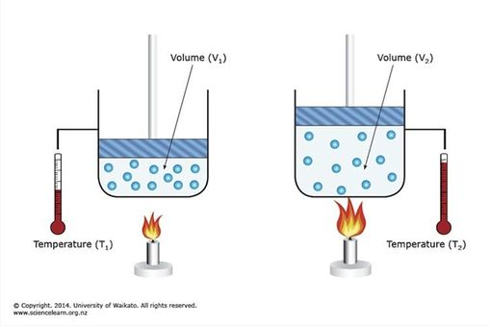
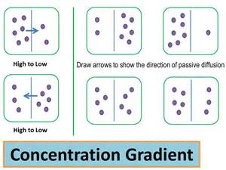

Factors influencing diffusion
1) Temperature. (Q: can you explain?)
2) (steepness of) Concentration gradient

Slide 15
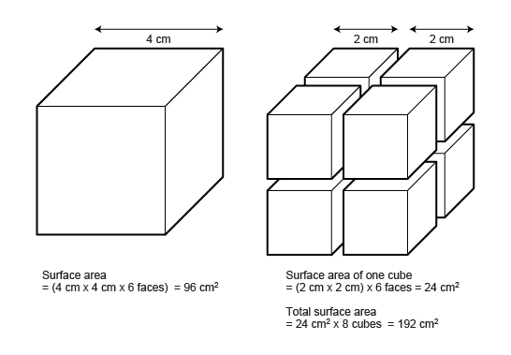
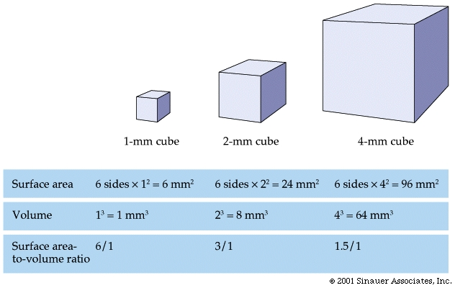
4) Distance travelled.
This places an upper limitation on cell size.
Q: Can a cell be as big as 1cm in diameter usually?
3) Surface area (across which diffusion happens) or surface area/volume ratio.

Slide 16
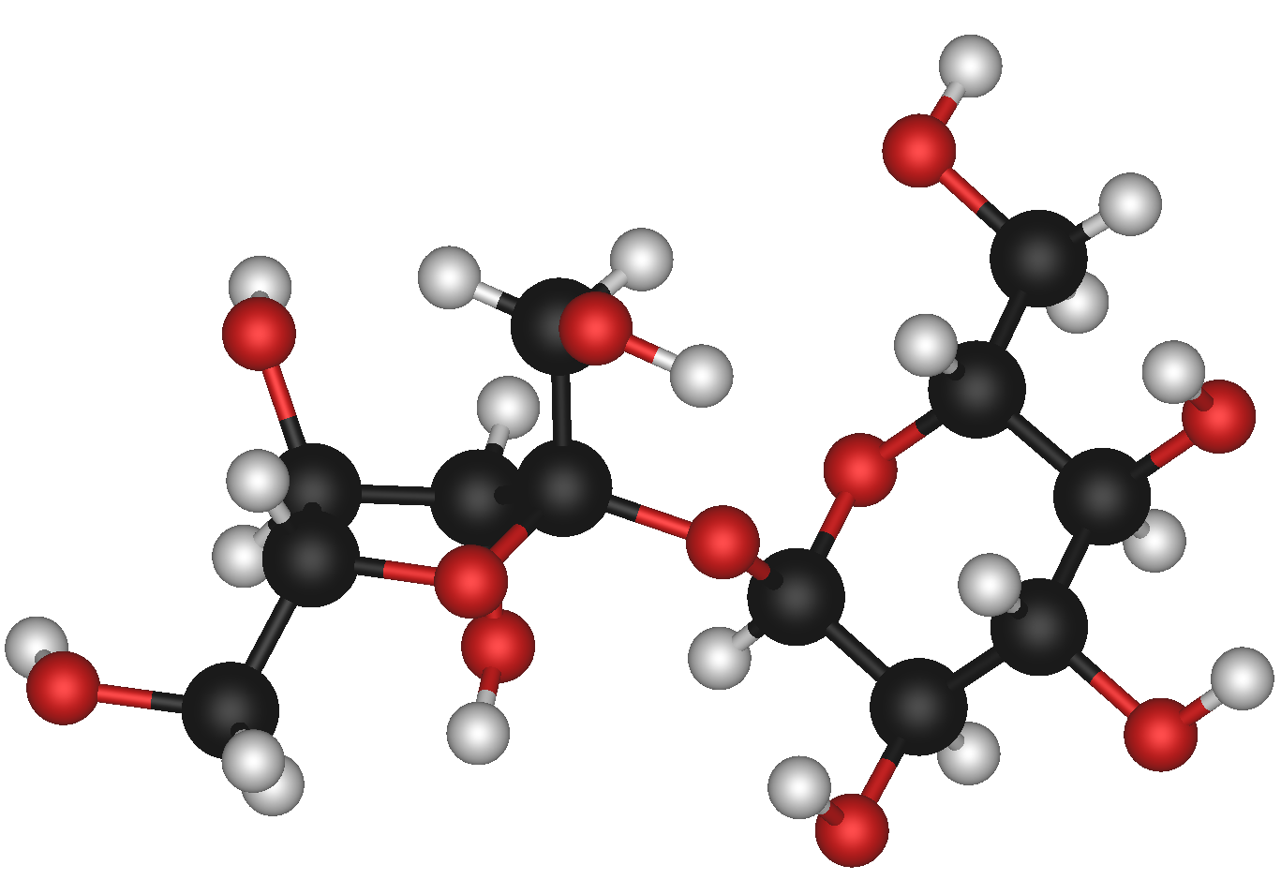
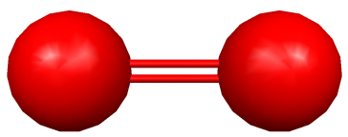
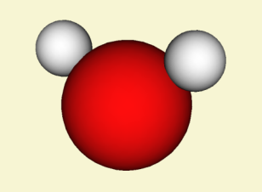
Other factors:
Molecular size, etc.

Slide 17
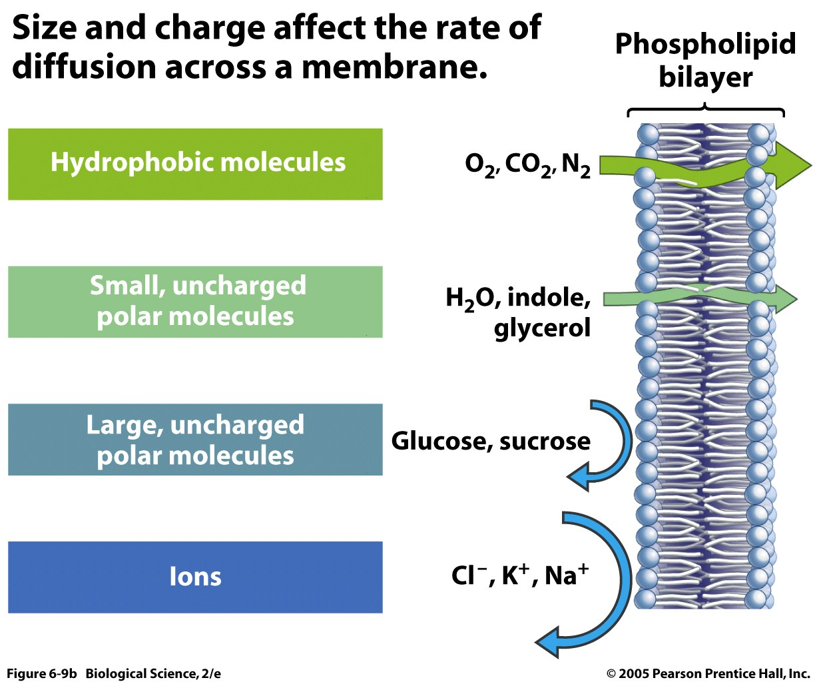

Question: What about fat soluble substances, such as Vitamin A/D/E/K? Can they pass cell membrane readily?
Diffusion in CELLS

Slide 18
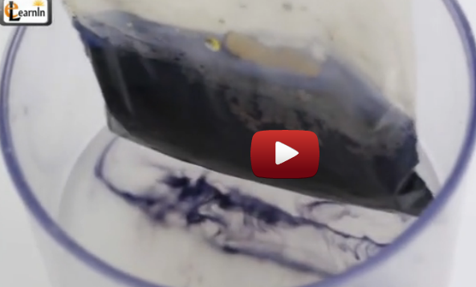
video
1. Diffusion _ Iodine starch experiment (TeacherTube)
http://www.teachertube.com/video/diffusion-and-osmosis-iodine-starch-experiment-with-bag-science-experiments-elearnin-333705

